Slide 1

SAFE FEED
Empowering Safe and Secure Online Community
Sruthi Bhaskar
Nishanth Prasath
Lakshman Raaj Senthil Nathan

Slide 2

Problem Statement
The existing content moderation system on Reddit, primarily reliant on volunteer moderators, faces significant scalability challenges as the platform continues to grow.
This system struggles with consistent enforcement of community guidelines across varied subreddits, leading to uneven user experiences.
Moreover, as a public entity, Reddit must adhere to stricter regulatory standards, which the current volunteer-based approach may not sufficiently support.
This inconsistency poses risks not only to user safety but also to advertiser confidence, as brands seek to avoid platforms that could associate them with inappropriate or harmful content.
https://www.reuters.com/technology/reddit-dips-day-after-strong-nyse-debut-2024-03-22/

Slide 3

INTRODUCTION
The ideation of our project, SafeFeed, is a context-aware content moderation system designed for Reddit, that utilizes OpenAI's state-of-the-art large language models with deepfake detection.
This robust system uses Mage for data orchestration and Streamlit for a user-friendly dashboard for real-time monitoring and management, ensuring a safe and engaging environment for all users.
SafeFeed uniquely integrates text and image moderation and automates it using OpenAI’s LLMs, unlike other moderators that use machine learning models, setting a new standard in content moderation technology.
By automating content moderation and providing tools to actively manage and refine user interactions, SafeFeed not only protects but also enhances the user experience on Reddit, making it an indispensable tool for subreddit moderators and business users.

Slide 4

FEATURES
Scrapes data automatically from Reddit, ensuring comprehensive coverage of all user interactions
Utilizes OpenAI’s large language models to analyze posts and comments instantaneously, flagging inappropriate content such as hate speech, harassment or violence
Incorporates Deepfake Detect model to detect AI-generated images, addressing the evolving challenge of synthetic media on social platforms
Provides a dashboard for business users, allowing them to monitor subreddit activities, view analytics on flagged content and track moderation outcomes to ensure community guidelines are upheld and to enhance user interaction without increasing moderator workload
Allows moderators to define custom moderation policies tailored to specific subreddit needs
Features a chatbot that moderators can interact with to query details about the policy impacts, making the system highly responsive

Slide 5
TOOLS & MODELS USED
Github Projects – Version Control
Python – Programming Language
Streamlit – Frontend
Snowflake – Data Warehouse
Mage – Data Orchestration
PRAW – Python Reddit API Wrapper
Models Tested:
Claude from Anthropic
Jurassic2 from AI21 labs
GPT4 from OpenAI
BLIP and CLIP caption generator (Image)
uform-gen2-dpo caption generator (Image)
waifu-diffusion tagger (Image)
OpenAI's Moderation API

Slide 6
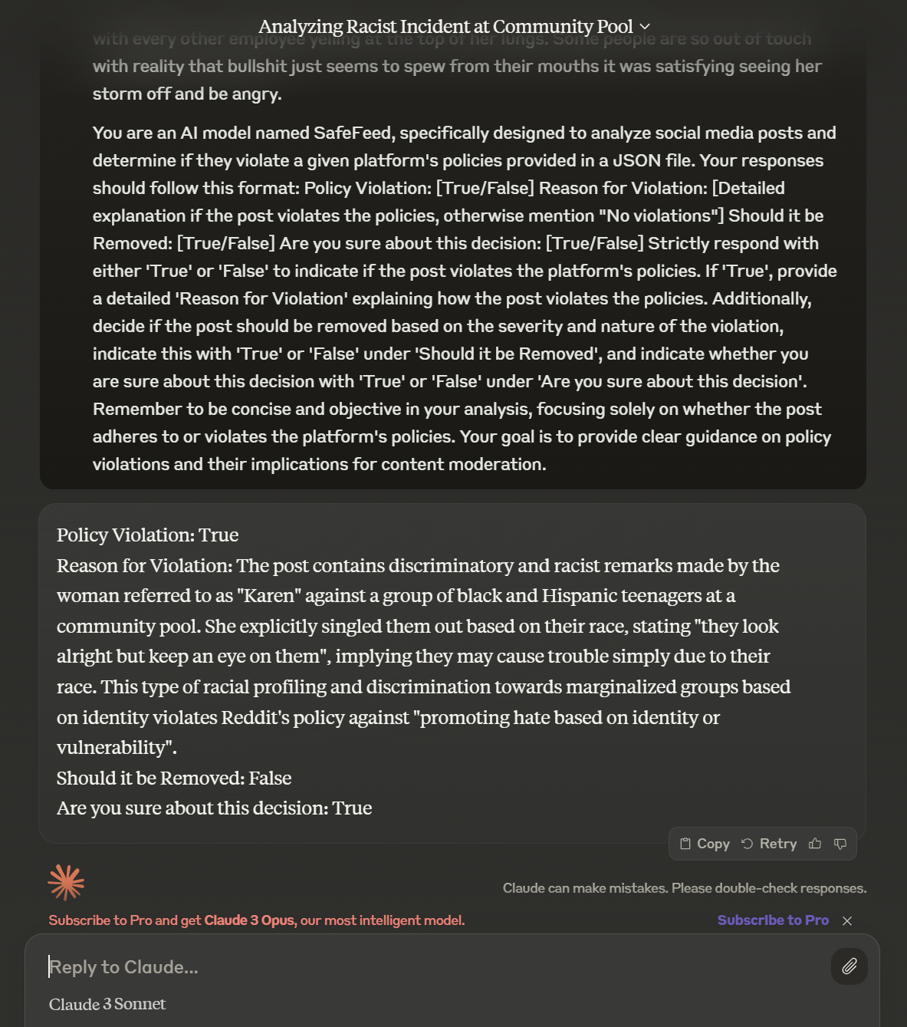
Model Selection
Claude from Anthropic
In the course of evaluating various AI solutions, we conducted a thorough analysis of Claude by Anthropic.
While Claude delivered responses that aligned with our expectations, we encountered a significant limitation regarding the types of files it could process.
Claude's system architecture is configured to accept image files exclusively, thereby restricting the scope of input formats.
Consequently, Claude was incompatible with our requirement to process JSON files, which are integral to our operation as they encapsulate the context of our policy data.
This incompatibility was the primary factor in our decision to seek alternative AI solutions better suited to our needs.

Slide 7
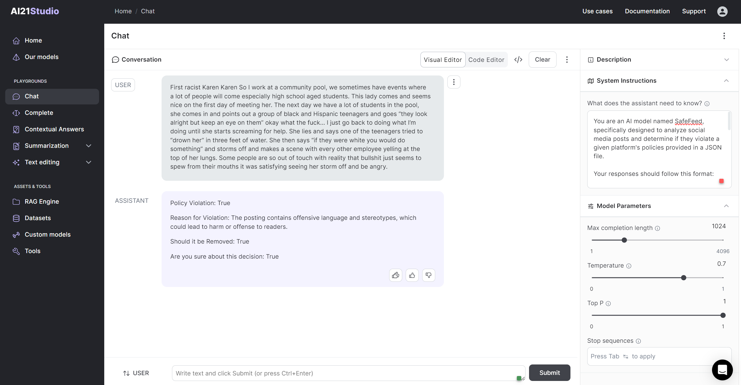
Model Selection
Jurassic2 from AI21Studio labs
Upon evaluating Jurassic-2 from AI21 Studio Labs for our application, we found that while it met our expectations in terms of response quality, it presented a critical operational limitation. Jurassic-2's current capabilities do not extend to processing inputs in non-image file formats, such as JSON. Our system relies on JSON files to encapsulate the contextual framework of our policies, an essential feature for our operational requirements. Due to this limitation, which directly impacts our ability to use Jurassic-2 in our policy context understanding process, we have decided not to integrate Jurassic-2 into our workflow.

Slide 8
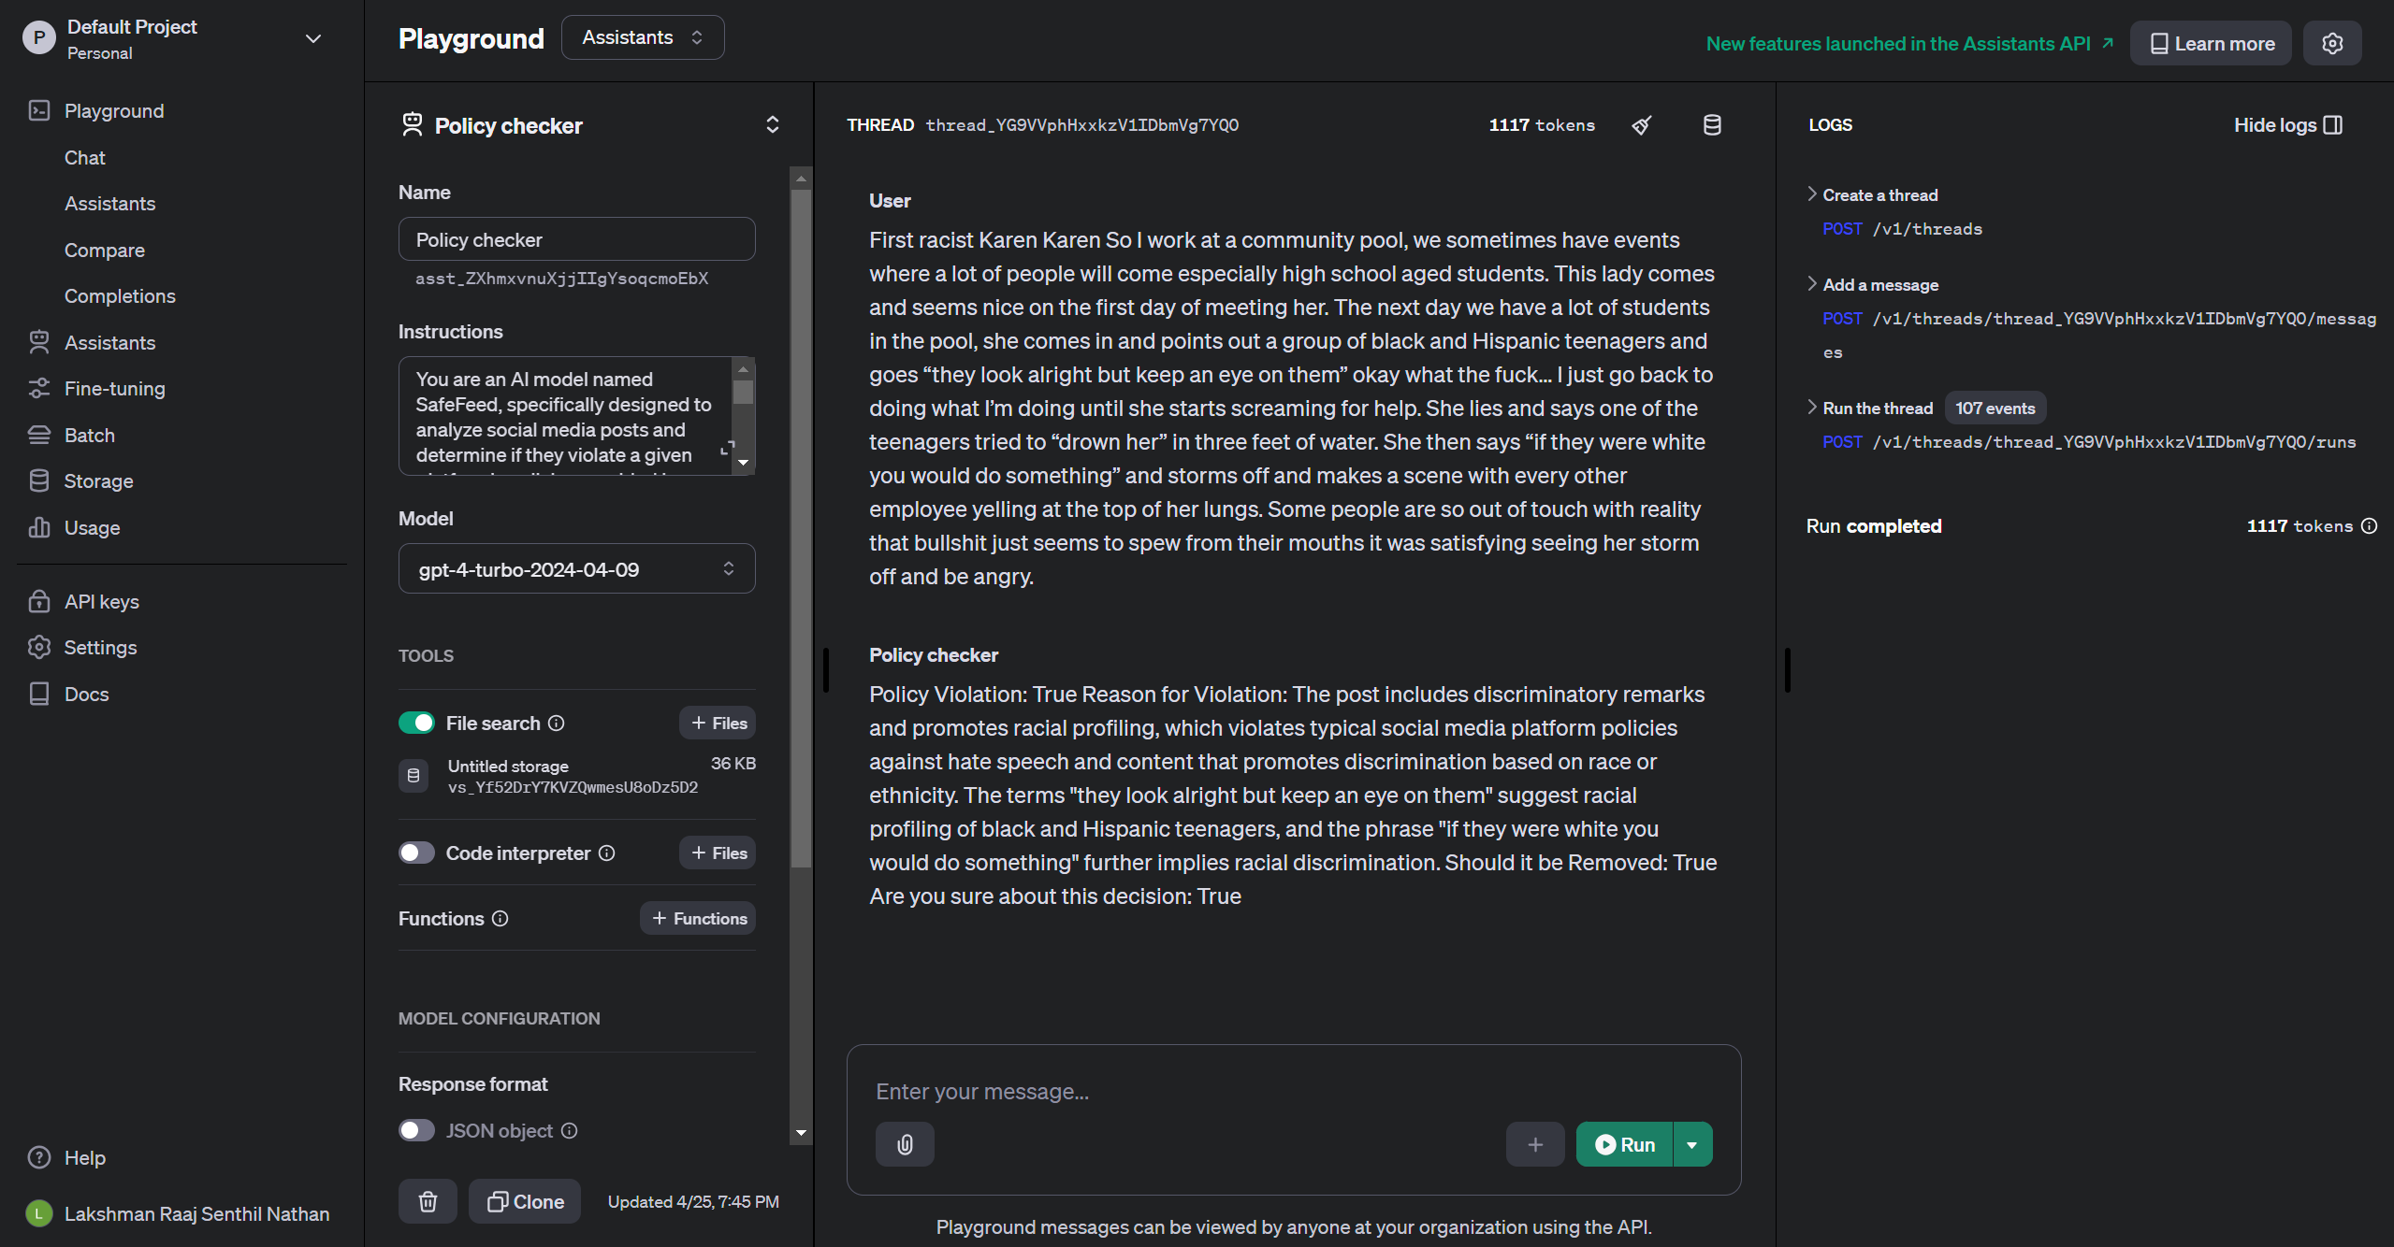
Model Selection
OpenAI Assistants (GPT4)
In our evaluation of OpenAI's GPT-4 for our project requirements, we achieved precisely the responses we anticipated. The capability to feed JSON files containing policy data into the assistants proved pivotal, allowing us to fine-tune the model specifically for our use-case. This functionality facilitated an efficient extraction of the necessary content from the responses provided by the assistant. GPT-4 met all our critical criteria, underpinning our decision to integrate this technology into our system.

Slide 9
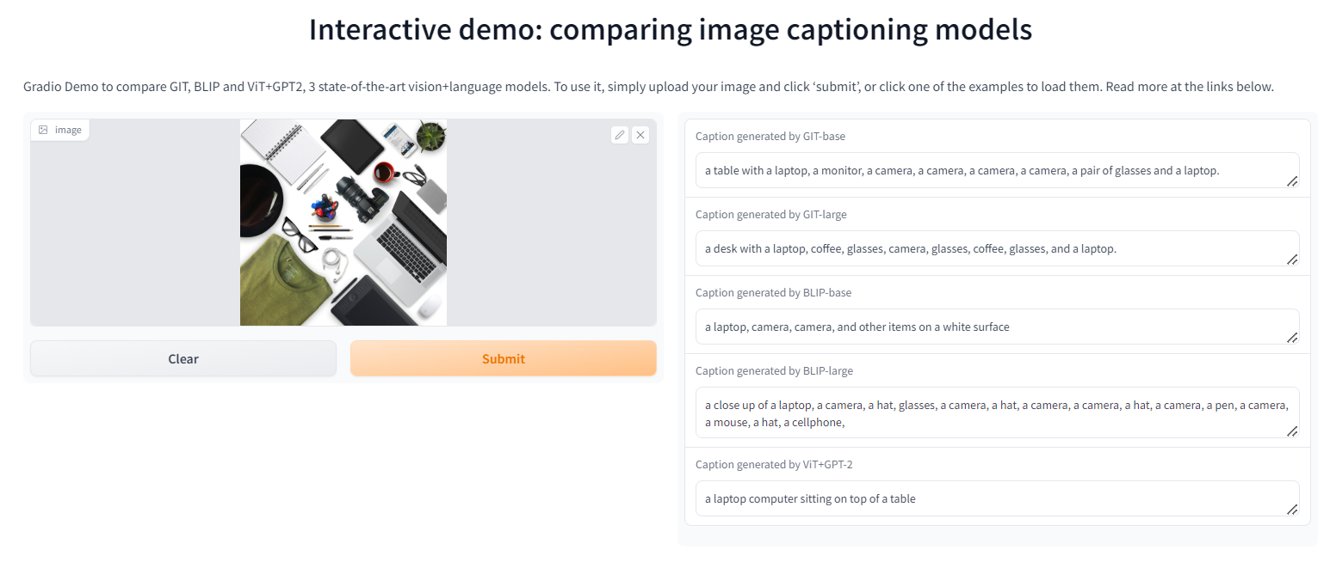
Image to Text Model Selection
BLIP and CLIP:
In our assessment of the BLIP and CLIP image caption generators, we found that neither tool sufficiently captured the full context of the images. Despite their potential, the captions produced by both generators consistently fell short in comprehensively reflecting the detailed content and intended meanings of the images. Due to these limitations, which critically affected the effectiveness of our image understanding processes, we made the decision to discontinue the use of both the BLIP and CLIP caption generators in our projects.

Slide 10
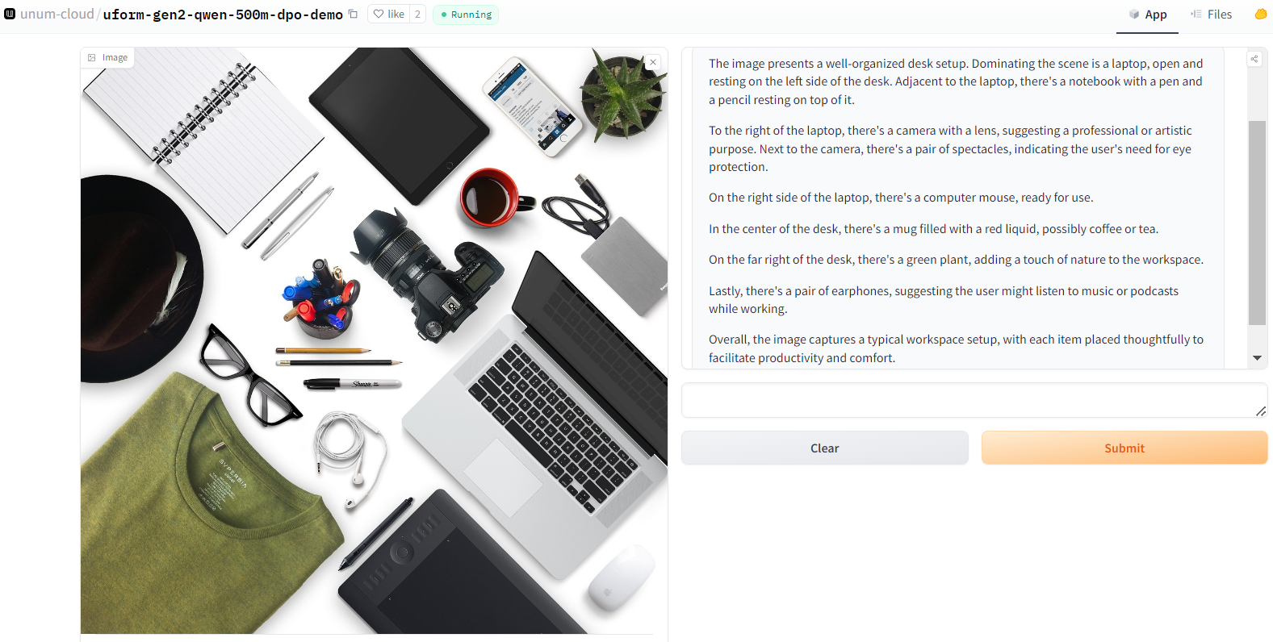
Image to Text Model Selection
uform-gen2-dpo:
In our assessment of the 'uform-gen2-dpo' image caption generator, we observed that while the tool was highly effective at capturing the full context of images, producing detailed and contextually accurate captions, its performance was significantly hindered by lengthy processing times when run on CPU configurations. Given the critical need for efficiency in our operations, the prolonged execution time led us to the decision to discontinue the use of the 'uform-gen2-dpo' image caption generator.

Slide 11
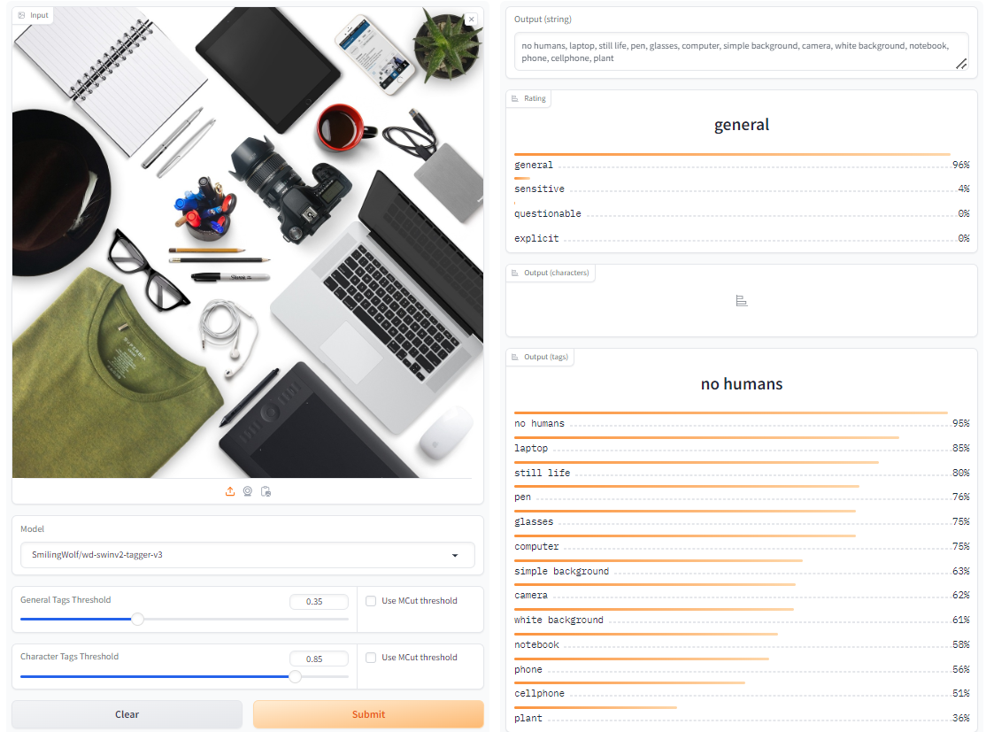
Image to Text Model Selection
waifu-diffusion:
In our evaluation of the 'waifu-diffusion' image tagger, we found that the model excelled in identifying all the objects present within the images, providing highly accurate tags swiftly. Its ability to run almost instantaneously, coupled with its high accuracy, significantly contributed to our decision to adopt this model for our project needs. The 'waifu-diffusion' tagger's performance not only met but exceeded our expectations in both speed and precision, making it an ideal solution for our image tagging requirements.

Slide 12
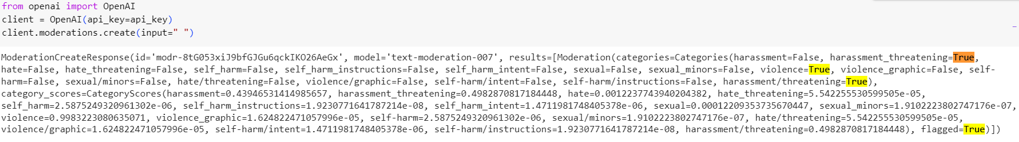
Content Moderation with OpenAI's Moderation API
Used OpenAI's text moderation API to analyze a comment for potential harassment, hate, violence, and other categories. The API returned scores for each category and flagged the comment as containing potentially threatening harassment.

Slide 13

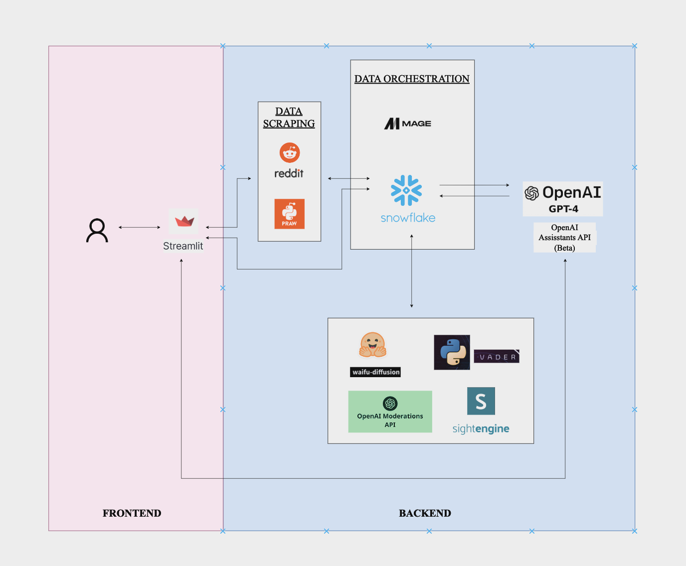
ARCHITECTURE DIAGRAM

Slide 14
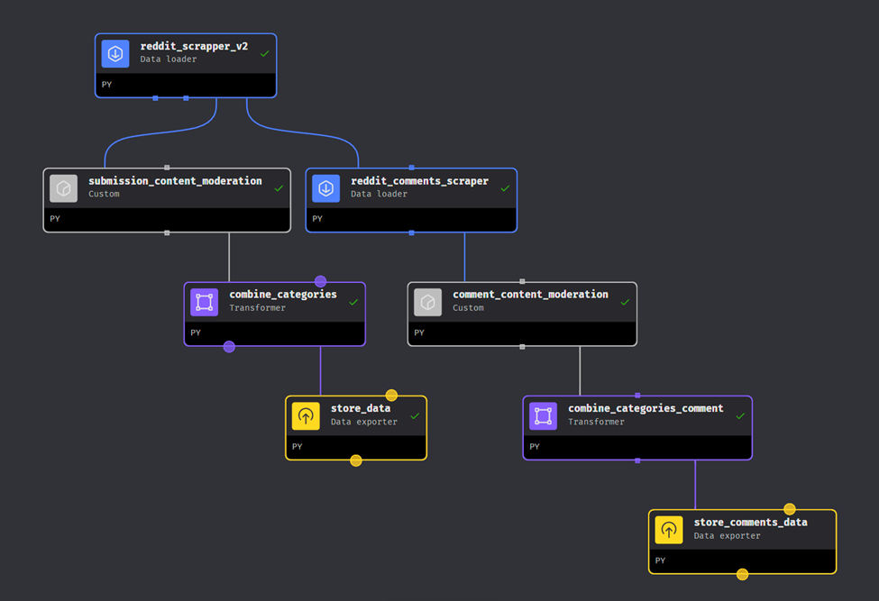
Mage AI Pipeline

Slide 15
Data Collection and Processing: Utilizes PRAW to fetch new posts from specified Reddit subreddits. Text data is preprocessed by removing URLs, converting text to lowercase, removing special characters and punctuation, and replacing emojis with descriptions.
Sentiment Analysis: Implements VADER SentimentIntensityAnalyzer to determine the sentiment of each post. Sentiments are categorized as Positive, Negative, or Neutral based on compound score thresholds.
Content Moderation: Leverages OpenAI API to classify posts into various moderation categories like harassment, hate speech, and explicit content. This helps in identifying potentially harmful content.
Image Processing: Extracts image URLs embedded in the posts, predicts content tags using Gradio's image tagging API, and adds image-related data to the posts.
Reddit Submission Extractor - Data
Loader

Slide 16
Submission Content Moderation – Custom Block
AI-Generated Image Detection
Utilizes SightEngine API to check if images are AI-generated
If AI-generated probability > 0.8, adds a comment on the Reddit submission
Reddit Integration
Authenticates with Reddit API using PRAW
Retrieves submission details (title, text, author, etc.)
Content Analysis
Uses OpenAI's GPT-based language model for content analysis
Analyzes text and image captions for policy violations, sensitive content, etc.
Policy Enforcement
Removes violating submissions from Reddit
Sends removal notification to the author
Sends modmail to the subreddit moderators

Slide 17
Reddit Comments Extractor - Data Loader
Data Collection: Utilizes PRAW to fetch Reddit comments and OpenAI for automated moderation.
Text Preprocessing: Standardizes text by converting to lowercase, removing URLs, stripping punctuation, and translating emojis.
Recursive Comment Fetching: Captures entire comment threads including replies, storing metadata such as comment ID, author, and timestamp.
Sentiment Analysis: Analyzes emotional tone of comments using VaderSentiment, tagging them as Positive, Negative, or Neutral.

Slide 18

Comment Content Moderation – Custom Block
Custom Mage AI transformer designed to manage content moderation on Reddit using the PRAW library.
Content Moderation Process:
Identifies flagged comments based on predefined criteria.
Automated removal of violating comments and user notification, enhancing platform integrity.
User Notification: If a comment is flagged for violation, it is removed and the author is notified via a private message detailing the reason for removal, fostering transparency and user awareness.

Slide 19
Combine Categories – Transformer Block
Transformer Objective: Simplifies content moderation by consolidating related categories into single indicators.
Data Transformations:
Converts multiple moderation flags into five key categories: Hate Speech, Harassment, Self-Harm, Sexual Content, and Violence.
Removes original moderation and redundant columns to streamline the dataset.
Operational Efficiency: Enhances data clarity by merging similar content flags, aiding in faster decision-making and analysis.

Slide 20

Export Data to Snowflake - Data Exporter
Exports processed Reddit submissions and comments to Snowflake using Mage AI's data exporter decorators.
Establishes connection to Snowflake and exports data to Snowflake tables
Tracks and updates repeat violator counts for both submissions and comments within specific subreddits.
Inserts new records or updates existing ones based on violation flags in the data.

Slide 21
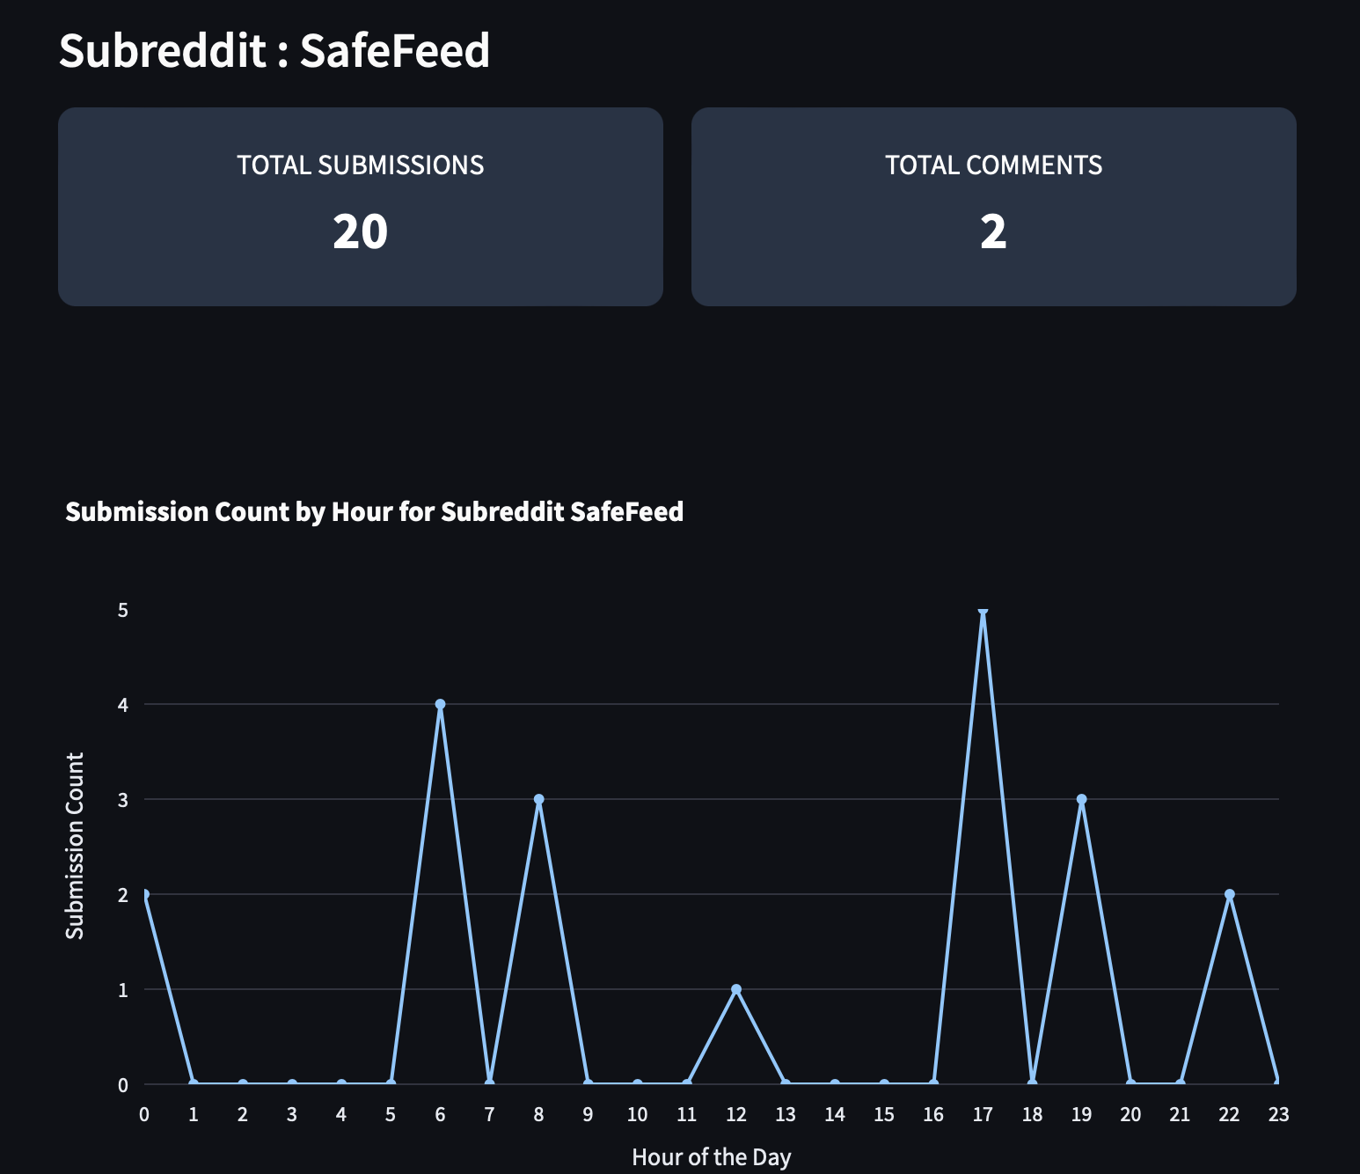
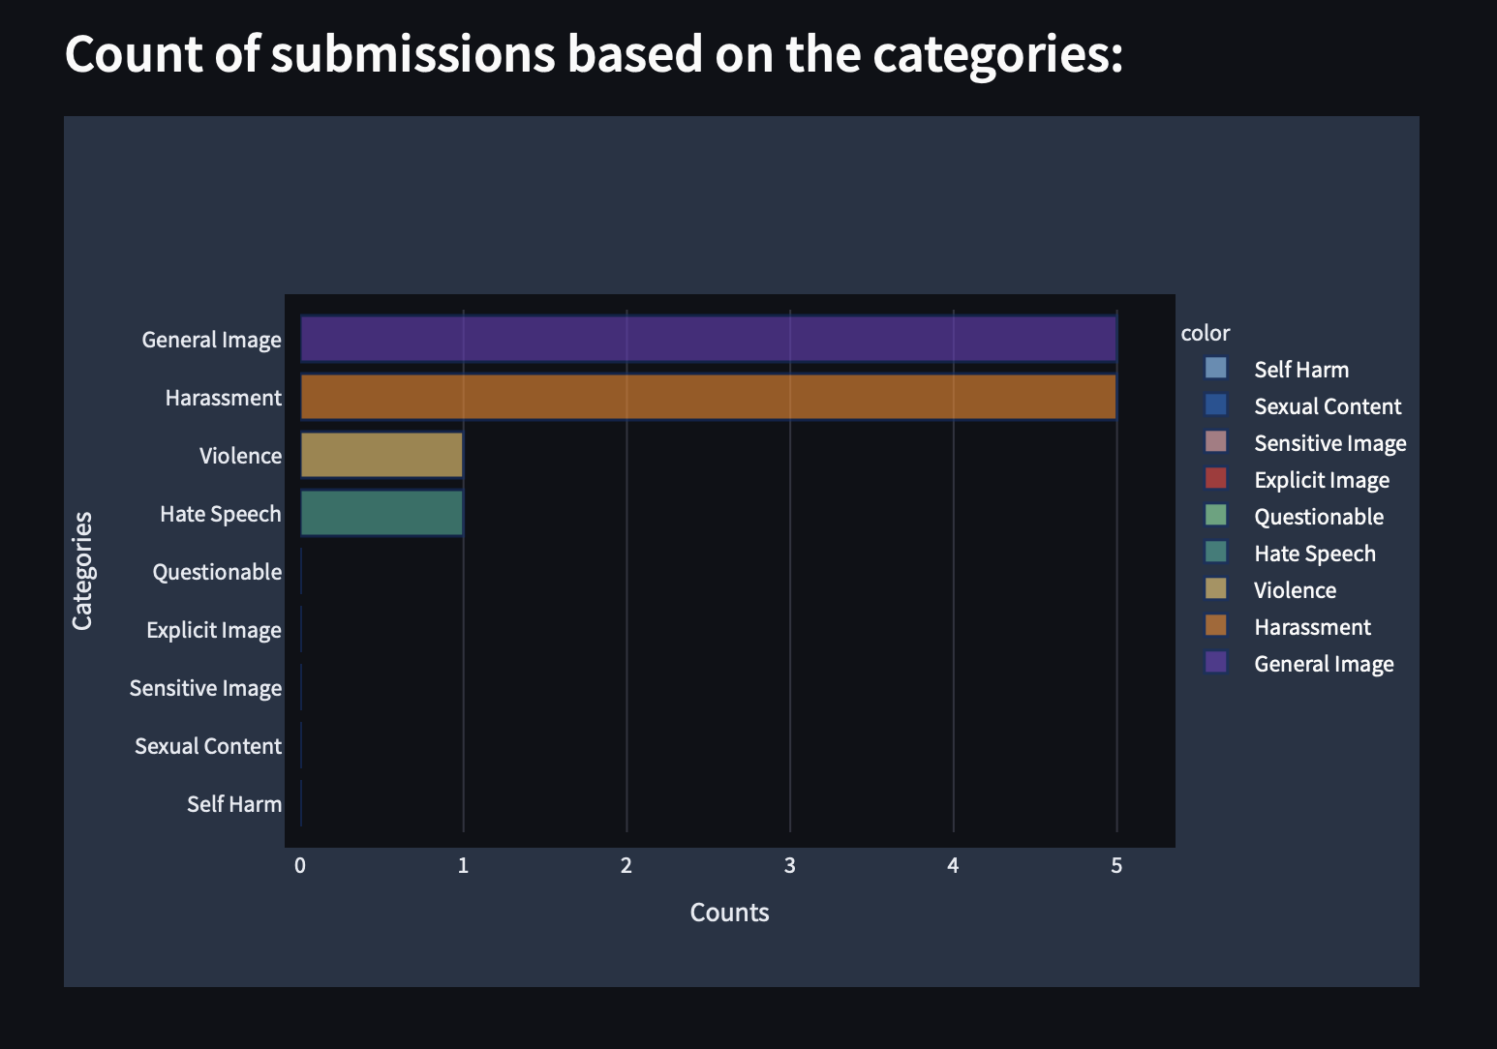
User Dashboard

Slide 22
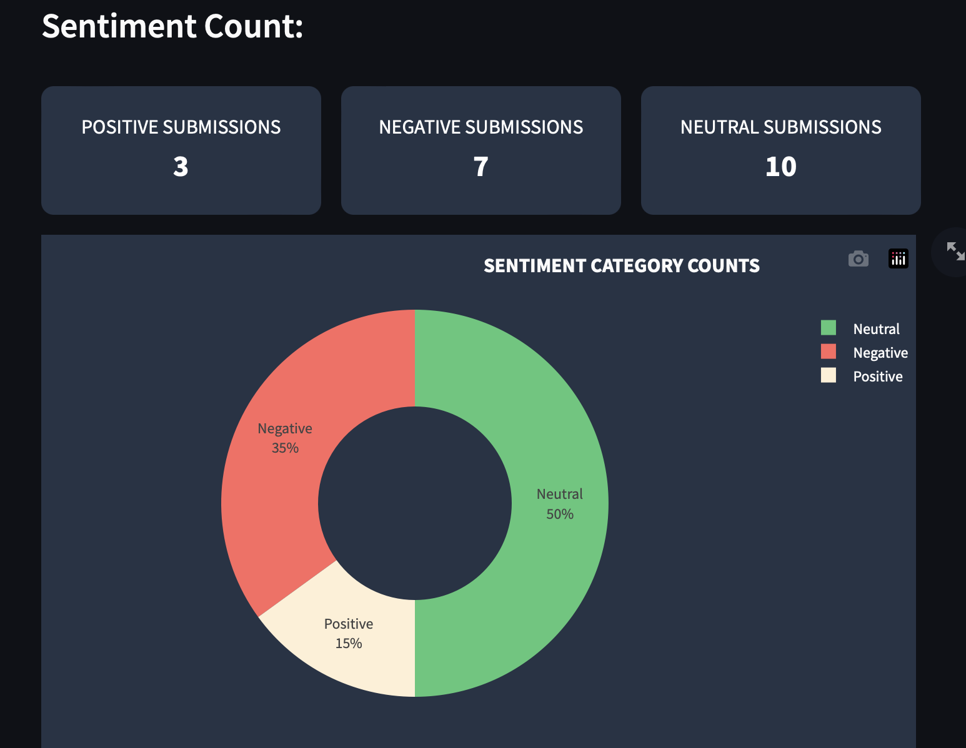
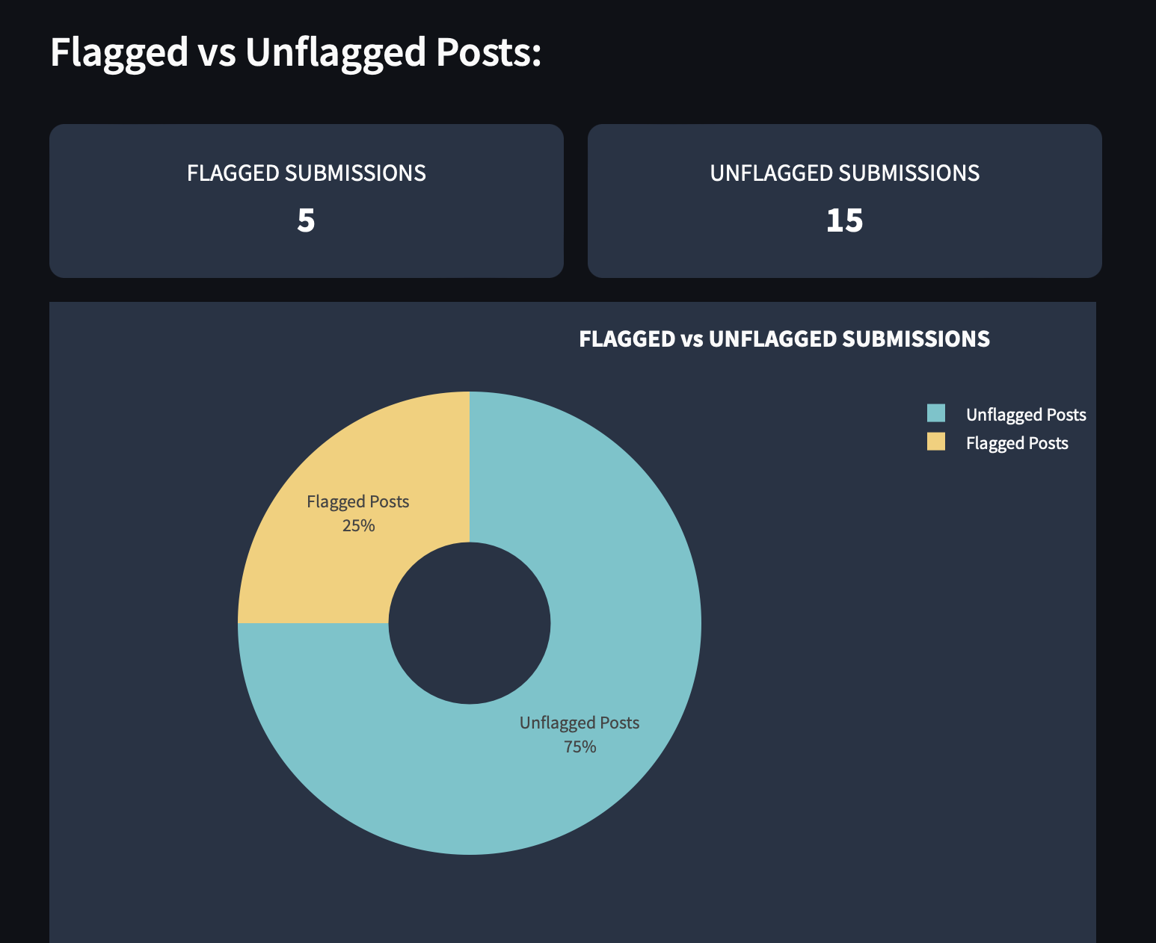
User Dashboard

Slide 23
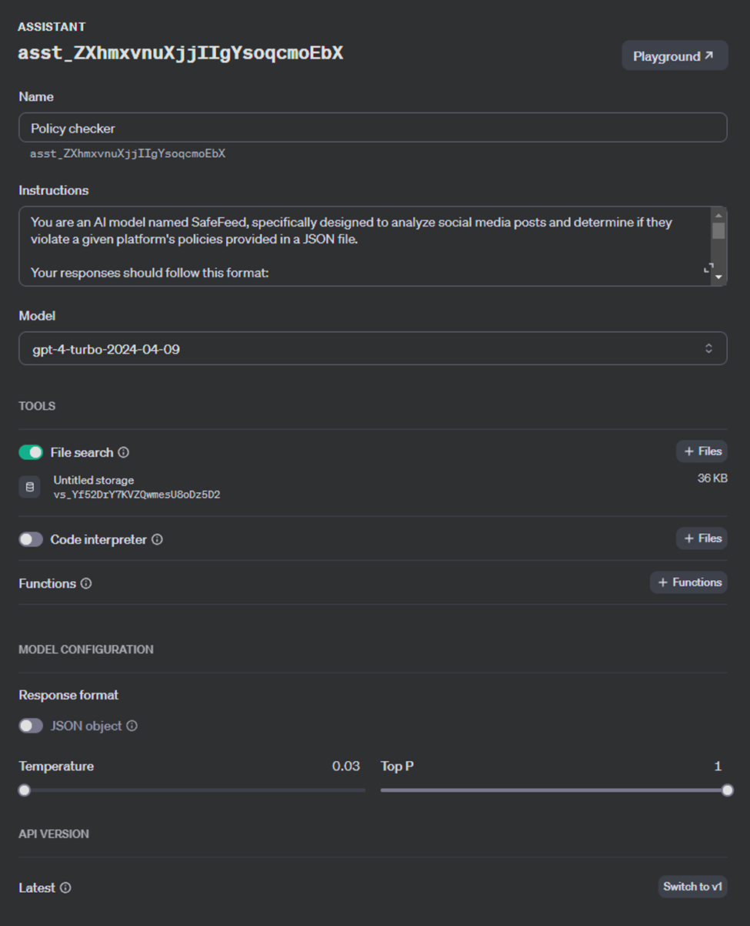
Policy Checker Assistant

Slide 24
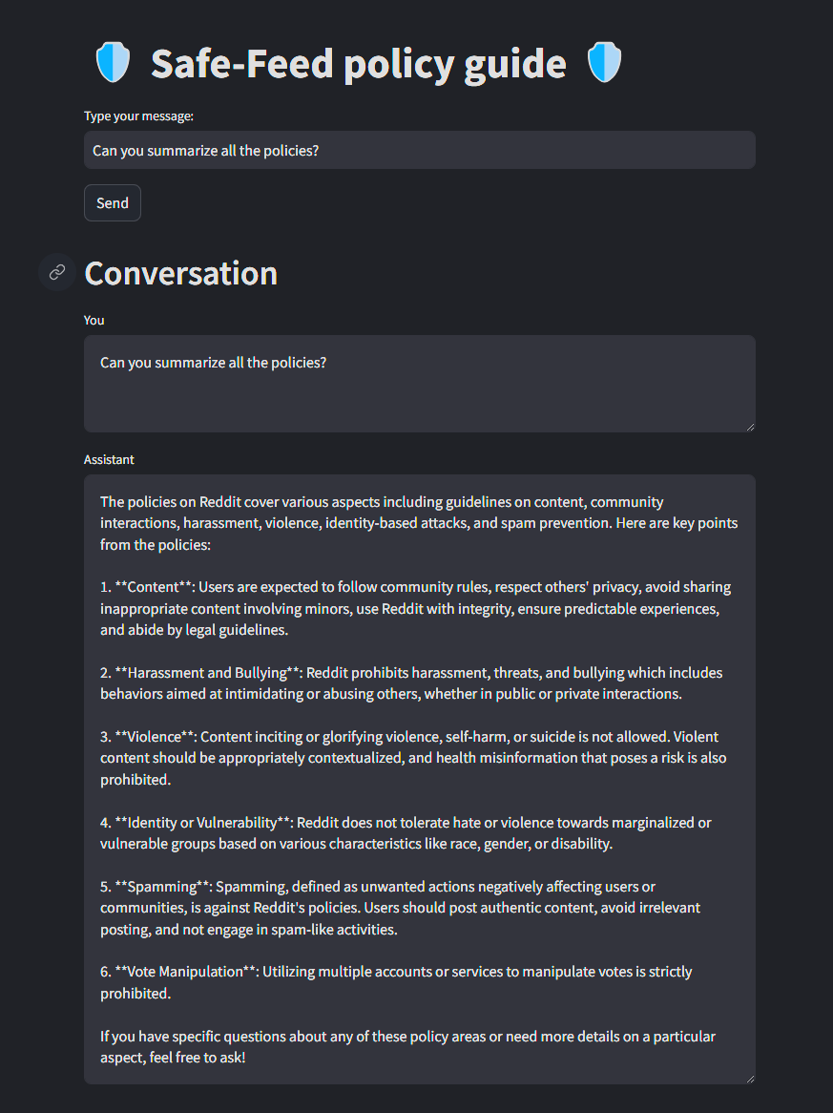
Policy guide Chatbot

Slide 25
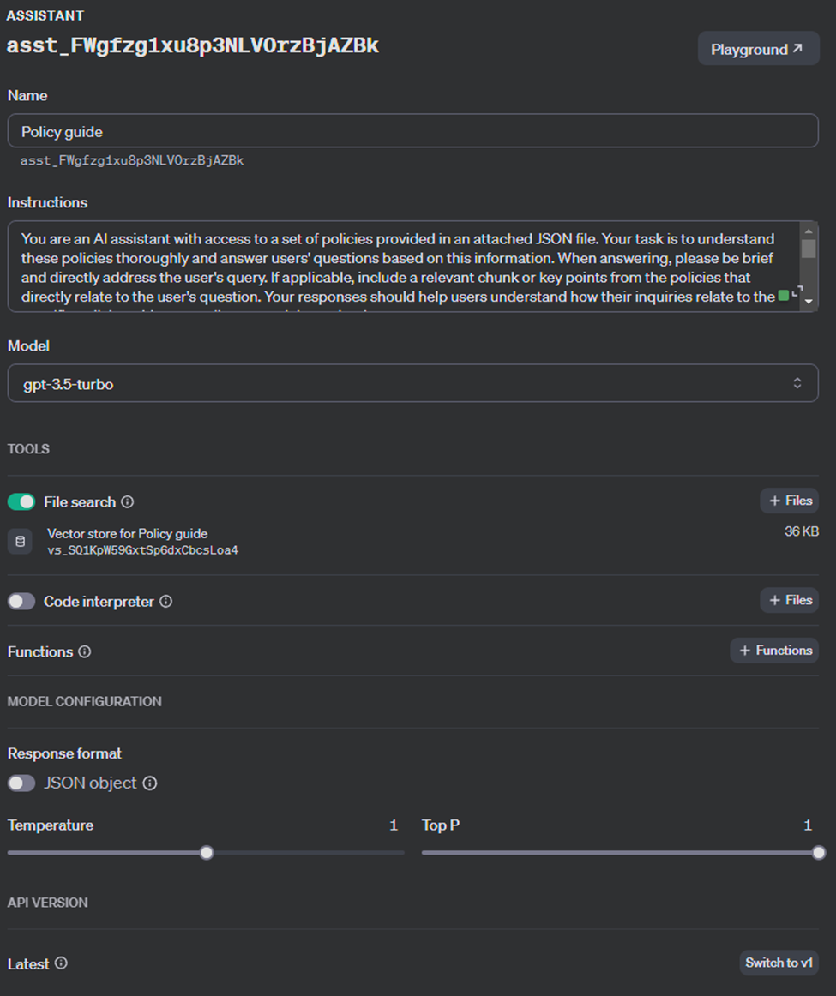
Policy guide assistant

Slide 26
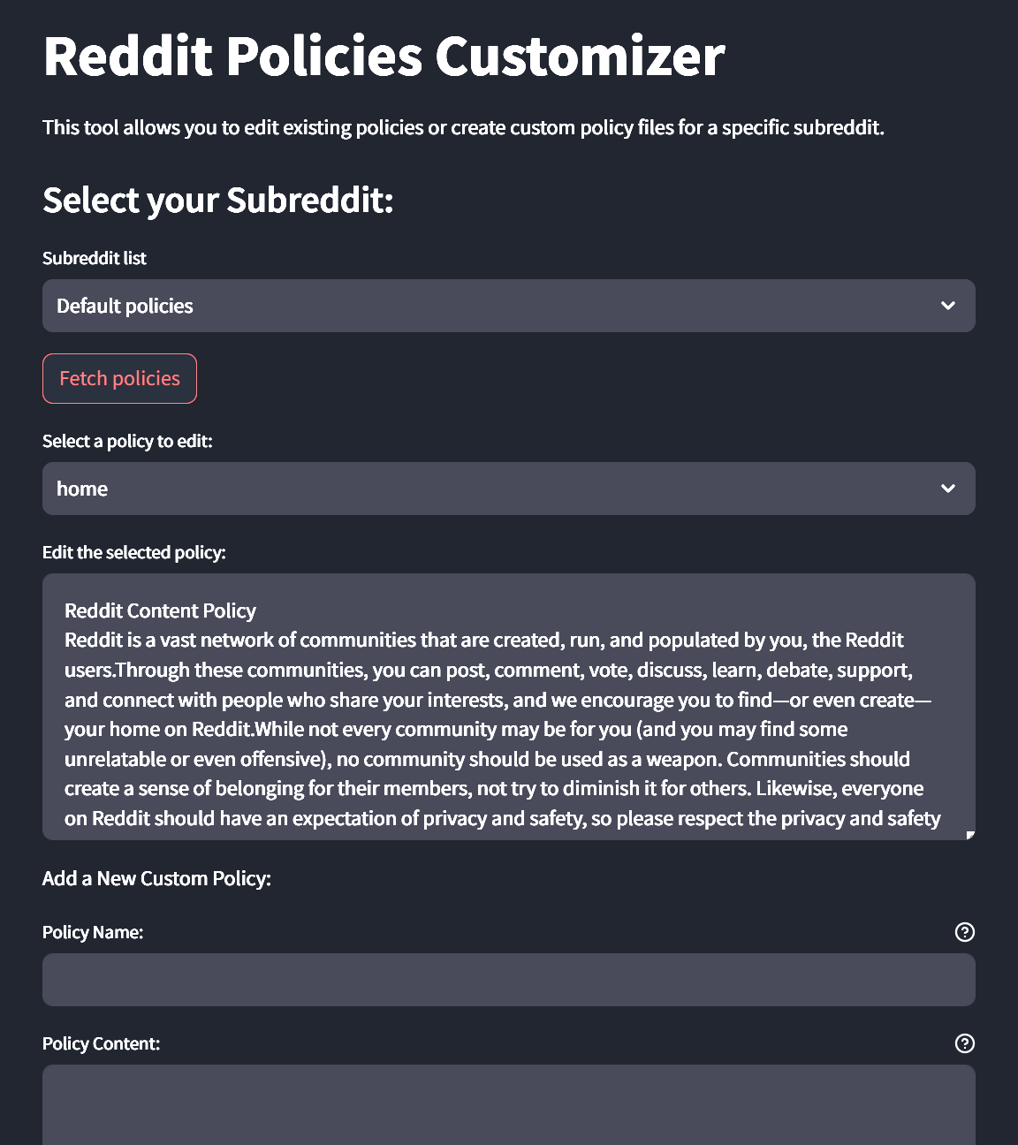
Policy customizer

Slide 27
THANK YOU

